Slide 1

Security Concerns in Proprietary and Open-source Software
Fabiola Welzenbach 01552712

Slide 2
Structure
Introduction
  Definition Software
  Definition of a Proprietary Software and Open-source Software
  History of Proprietary and Open-Source
  Licensing
Comparison of Proprietary Software and Open-Source Software
  Advantages
  Disadvantages
Security Concerns
  Security Concerns Proprietary
  Security Concerns Open-Source
  Application of Proprietary and Open-Source Software
Opportunities to increase Security
SAP & Microsoft Strategy
Conclusion

Slide 3
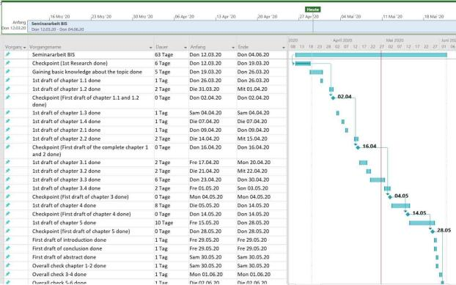
Timeline (MS Project)

