Slide 1
Determining Prices in the Information Technology Age: How Can "Just Prices" Be Achieved for Good?
Mariusz Nitecki 11711554

Slide 2
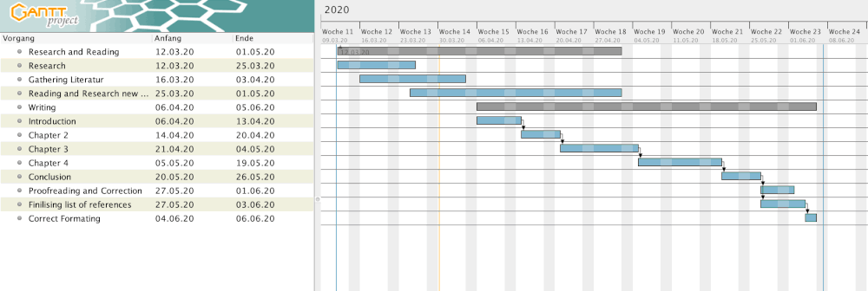
Gantt-Chart

Slide 3
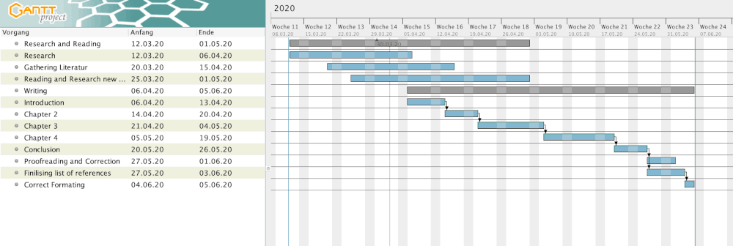
Gantt-Chart Updated

Slide 4
TABLE OF CONTENTS
1. Introduction
2. Just Prices
  What Are “Just Prices”
    2.1.1 Ethics Of “Just Prices” Over History
    2.1.2 How “Just Prices” Are Determined
  2.2 Economic Viability of “Just Prices”
3. Currently Practiced Pricing Schemes
  3.1 Mobile Providers
  3.2 Streaming Providers
  3.3 Bundling
4. Use of Technology For Price Setting
  4.1 Processing Of Personal Data To Determine Fair Prices
    4.1.1 Customer Profiling
      4.1.1.1 Behavior Data
      4.1.1.2 Non-Behavioral Data
    4.1.2 Prediction Models
  4.2 Use Of Artificial Intelligence
  4.3 Data Protection Concerns And Ethics
5. Conclusion

