Slide 1
Security Concerns in Proprietary and Opensource Software
Nikolaus Vetter
01553126

Slide 2
Table of Content
Abstract
Introduction
Security Concerns
General Issues
Auditing Methods
User Perception
Comparison of Concepts
Open Source Software
Different Approaches
Licences
Proprietary Software
General Approach
Licences
Conclusion
Table of Figures
Reference List

Slide 3
Sources
Licences – What is Open-Source?
TrueCrypt - Case
Issues

Slide 4
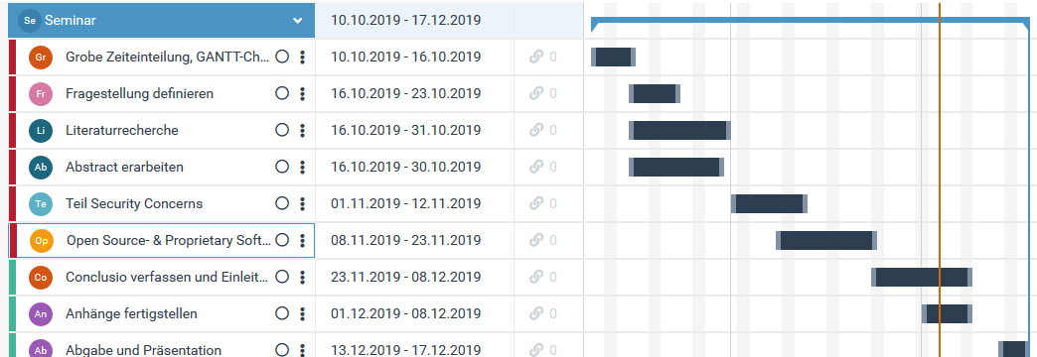
Gantt-Chart

