Slide 1
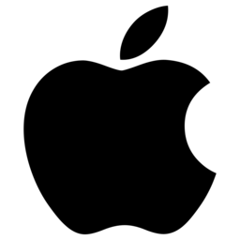
Proprietary vs. Open Markets in IT Apple, Microsoft, Google
Final Presentation
20.06.
By Bálint RÉPÁSI

Slide 2
Table of contents
Introduction
Conceptual Background
2.1 Intellectual Property
2.2 Ownership and Licensing
2.3 Proprietary Software Model considering the Market Attributes
2.3.1 Network effect
2.3.2 Low Marginal Costs Relative to Average Costs
2.3.3 Software as a Durable Good
2.3.4 Rapid Technological Change
Software Distribution Process
3.1 Mobile Devices
3.2 Personal Computers
3.3 Enterprise Applications

Slide 3
Table of contents
Creating Proprietary Markets
4.1 Preinstalled Operating Systems
4.2 Preinstalled Applications
4.2.1 Bloatware
4.2.2 Functional Applications
4.3 Controlled Ecosystems
4.3.1 Apple’s Devices
4.3.2 Microsoft’s Software and Services
4.3.3 Google’s Services
Impact on the Market Openness
5.1 Consumer Market Analysis
5.2 Business Market Analysis
5.3 Recent Trends and Predictions
Conclusion

Slide 4
Conceptual Background
Intellectual Property Rights (IRPS):
“the main social purpose of protection of copyright and related rights is to encourage and reward creative work.”
Ownership and licensing:
Ownership still belongs to developer
Different software licenses → different rights for the user
Controversial areas → used software?
Software market attributes
Using them to create proprietary markets

Slide 5
Software Distribution Process
Mobile devices
Centralized mobile application portals
Two-sided markets
Tight control → advantage for platform owner → harm competition? (Sotify vs. Apple)
Personal computers
Trend of centralization
Lack of success yet
Enterprises
Volume licensing
Bundling
Software as Service (SaaS)

Slide 6
Creating Proprietary Markets
Preinstalled operating systems
Convenient for users
Impact on market freedom
Warranty issues
Preinstalled applications
Business model
Legal cases (Internet Explorer, Google Apps)
Controlled ecosystems
Devices
Software
Services

Slide 7
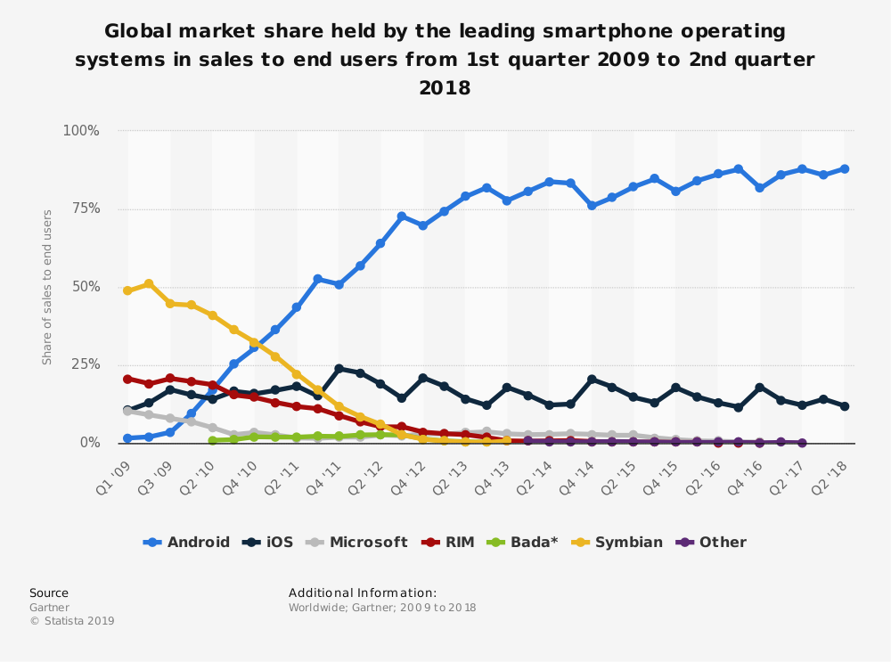
Impact on Market Openness

Slide 8
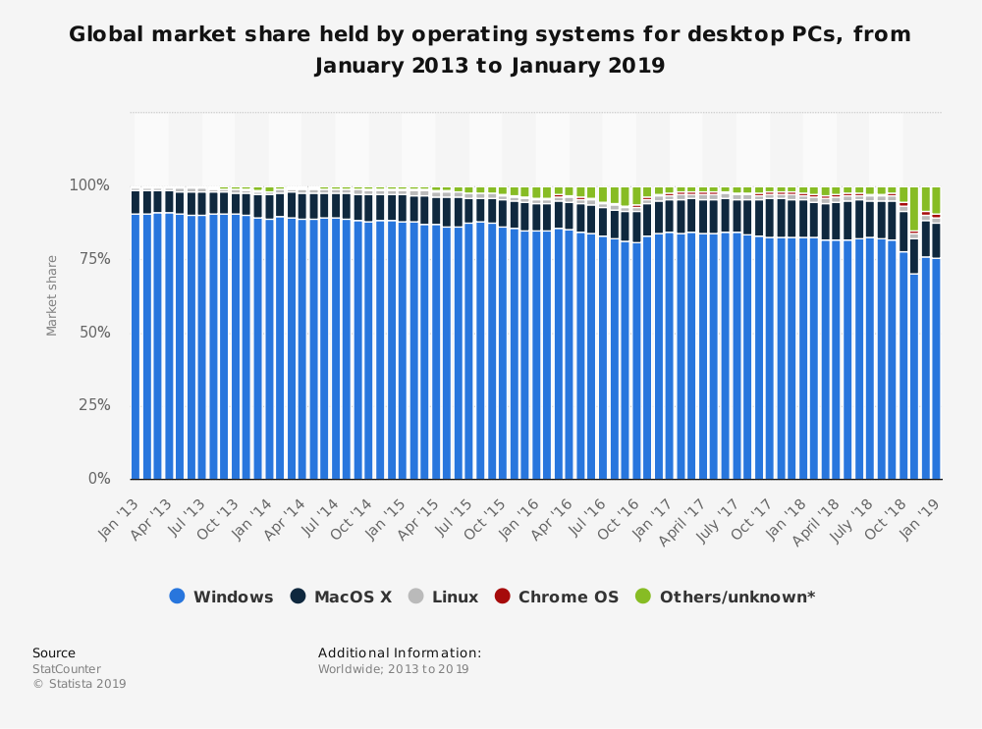
Impact on Market Openness

