Slide 1
Beyond JavaScript
Adding ooRexx and other JSR-223 Scripting Languages to the JavaFX WebView Control.
Maximilian Wannemacher

Slide 2
Why?
“
The by-design purpose of JavaScript was to make the monkey dance when you moused over it. Scripts were often a single line. We considered ten line scripts to be pretty normal, hundred line scripts to be huge, and thousand line scripts were unheard of.
- Eric Lippert

Slide 3
Why?
Concentrated power/responsibility
Different languages for different tasks
Personal Preference
Libraries

Slide 4
How?
JavaFX Webview | Java Scripting Framework | ScriptEngines

Slide 5
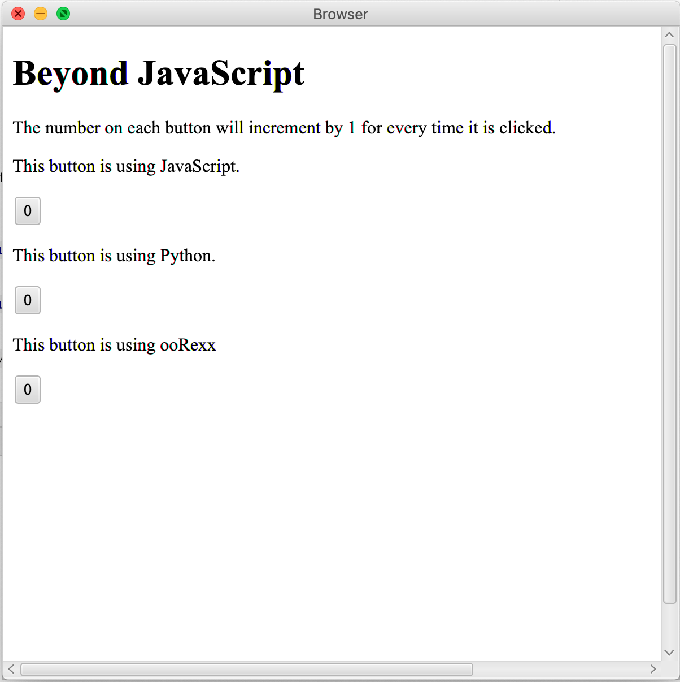
Result
A minimal Java-based
browser application
capable of displaying
websites and evaluating
scripts of multiple
languages.

Slide 6
Things that work
Displaying .html pages
Handling external files
Accessing DOM
Evaluating scripts
Invoking functions
~ Handling DOM events

Slide 7
<script type="text/javascript"> print("Hello world from JavaScript!"); var clickCount = 0; function testFunctionJS(arg){ clickCount += 1; arg.textContent = clickCount; } </script>
testfile.html

Slide 8
<script type="text/python"> print("Hello world from Python!") clickCount = 0 def testFunctionPy(arg): global clickCount clickCount += 1 arg.textContent = str(clickCount) </script>
testfile.html

Slide 9
<script type="text/oorexx"> say "Hello world from ooRexx!" .local~clickCount = 0 exit ::ROUTINE testFunctionRexx public button = arg(1) .local~clickCount += 1 button~textContent = .local~clickCount return </script>
testfile.html

Slide 10
Things that don’t work (yet)
Mixing and matching languages
DOM events other than onclick
Some DOM event oddities
Browser replacement

Slide 11
Conclusion
Java can be used to create a platform for language independent web scripting.
While the current implementation is not perfect, it can serve as a stepping stone for future improvement.

