Slide 1
Apache 2.0 vs. GPLv3
Hong Gu

Slide 2
FOSS - Free Open Source Software
A methodology for developing software
There are conditions with FOSS licenses
Reusal of software packages

Slide 3
Free Software
Freedom in using the software
Four freedoms
User controls software
Free doesn’t mean non-commercial

Slide 4
Open Source
Open exchange, joint participation, transparency and community-driven development
Few criterias have to be fulfilled:
Free redistribution
Software must come with the software
No discrimination
Not allowed to be restricted to a certain area

Slide 5
Software license
What is a software license
What is not a software license

Slide 6
Assessment of GPL
GPL (General Public License) is a copyleft license
GPLv3 published June 2007
New section to deal with technological and legal advancements
Anti-DRM Section
Protection against patent threats
LGPL (Lesser General Public License) - Use not advised by the GNU foundation

Slide 7
Assessment of GPL
(A closer look at the Anti-DRM section)
Places strong restrictions
Most discussed one out of all the changes
Para-copyright measures shouldn’t apply to GPLv3
Use of modified software shouldn’t be prevented by the hardware
Case: TiVo
Increasing number of hardware manufacturers trying to restrict user freedom

Slide 8
Assessment of GPL
(A closer look at the Anti-DRM section)
Linus Torvald criticizing GPLv3
Reasonable for manufacturers to forbid modified software
FSF aim isn’t to control device manufacturers
Anti-DRM could decrease corporate contribution
Could potentially weaken the FOSS movement
GPLv3 is considered as “viral”
However, most companies won’t really be affected by the Anti-DRM section

Slide 9
Assessment of GPL
(Software Patents)
Software Patents cripple innovation
Contributors grant patents
Aims to prevent patent infringement lawsuit
Some companies may fear putting their patent portfolio in danger
Patent section balances power

Slide 10
Assessment of Apache License 2.0
A permissive open source license
Rights apply to both licenses and patents
Copyright license
Patent license
Redistribution
Contributions

Slide 11
Comparison of the two Licenses
Developers seem to prefer GPL
Enterprises like Apache
Rise of Open Source and Apache-style licensing
GPL losing popularity
Too many restrictions with GPL

Slide 12
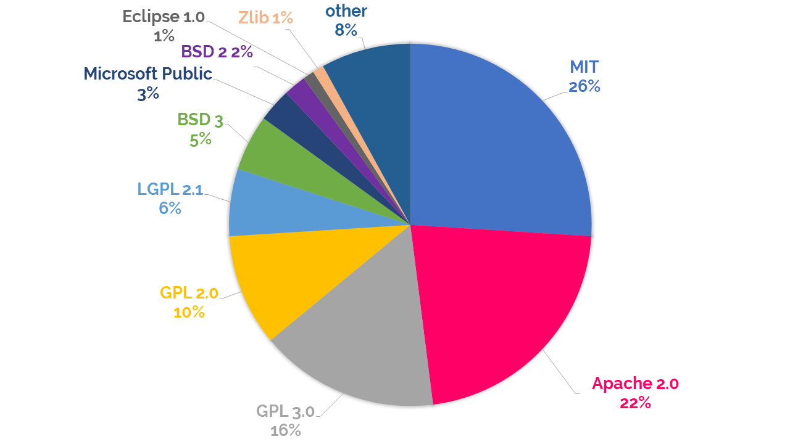

Slide 13
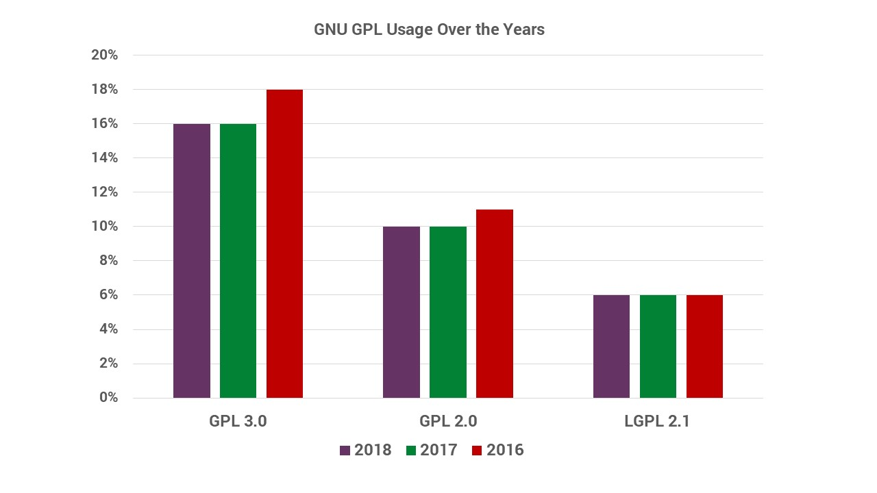

Slide 14
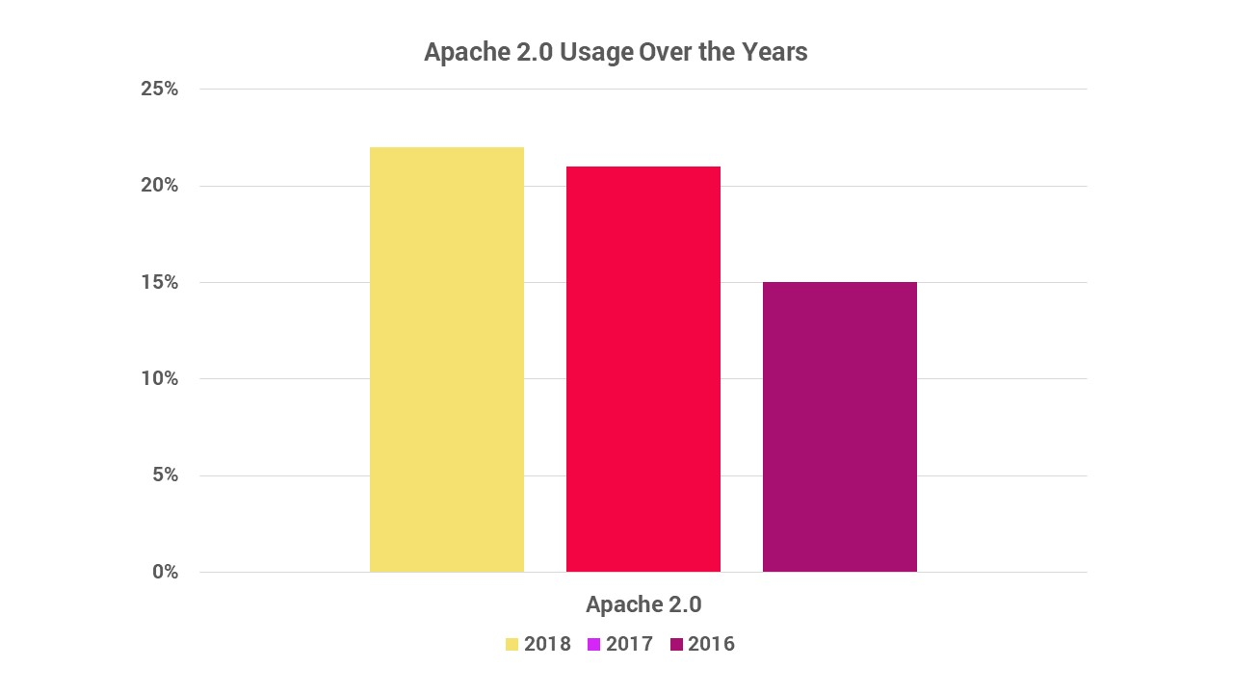

Slide 15
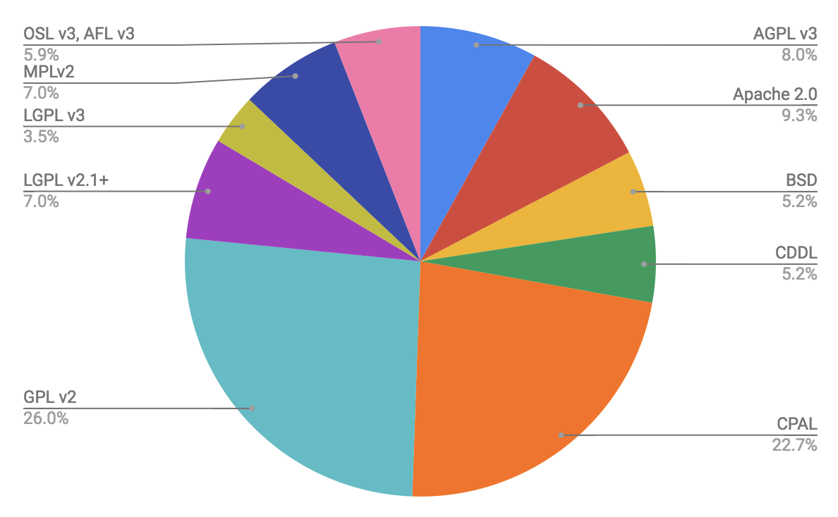

Slide 16
