Slide 1
Projektpräsentation BetterSafe
Elias Haueis und Antonia Buchner

Slide 2
BetterSafe
UI(javaFX)
BetterSafecontroller.rex
BetterSafe.fxml
BetterSafe.rex
BetterSafe.java

Slide 3
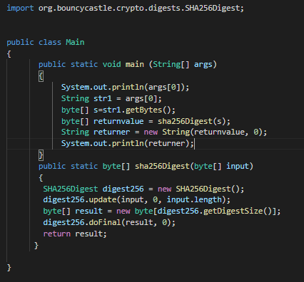
BetterSafe.java
BouncyCastle
Class: SHA256Digest
SHA256: cryptographic hash function

Slide 4
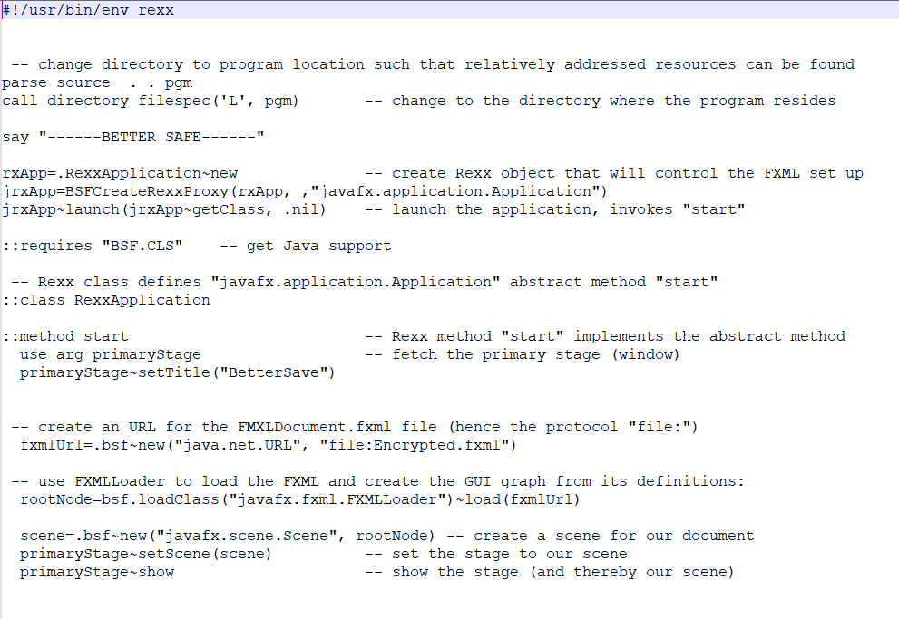
BetterSafe.rex

Slide 5
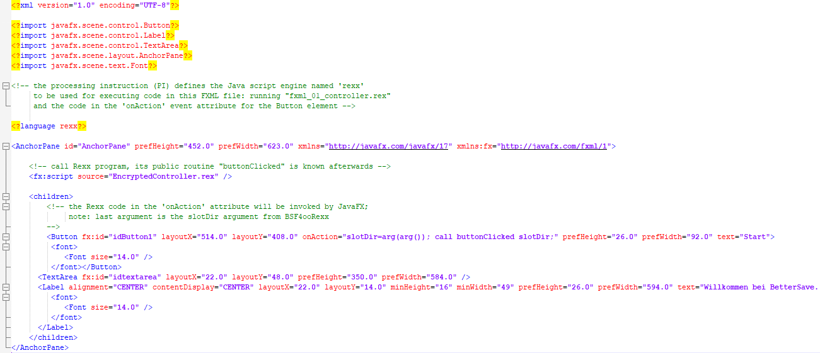
BetterSafe.fxml

Slide 6
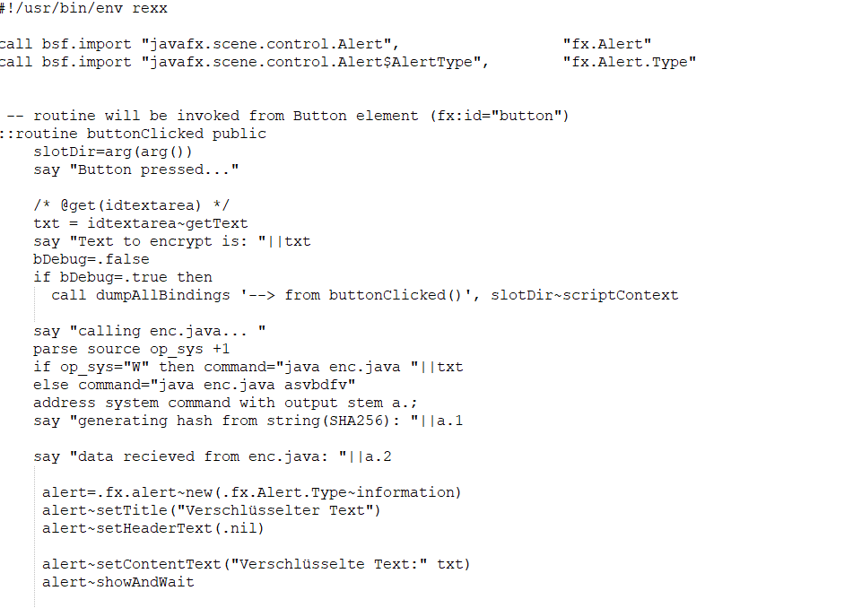
BetterSafeController.rex

